Slide 1
Welcome
To Mrs. Conover’s class. We will challenge ourselves and learn skills that will prepare us for the future.

Slide 2
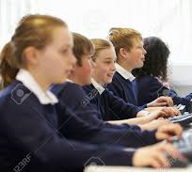
Classroom Procedures
What we do in our classroom so that we can learn.

Slide 3
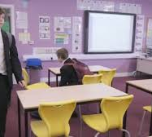
Arrival
Walk quietly into classroom.
Turn in assignments.
Start bell ringer activity.

Slide 4
Tardy
Get a tardy slip from the office.
Enter quietly and begin working.

Slide 5
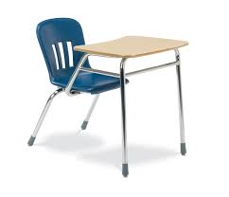
Absence
Pick up missed work.
Ask group member for notes.
Makeup work (1 day for each missed).

Slide 6
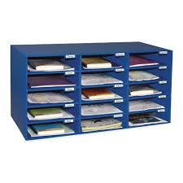
Homework
Homework is due the next day.
Place homework in bin for your class period.
Late work will be deducted 5 points for each day late.

Slide 7
Attention
When I raise my hand, stop, look and listen.

Slide 8
Getting teacher attention
Quietly raise your hand.
Wait for me to call on you.
Call my name if I don’t respond within 1 minute.

Slide 9
Restroom
If I am in middle of instruction, wait until finished.
Quietly raise your hand and ask.
Take pass and sign out/back in.

Slide 10
Collaborative Groups
Participate and contribute.
Offer and ask for help.
Treat others with respect.

Slide 11
Lining Up/Hallway
Quietly line up.
Walk quietly to destination.
Show respect for our learning environment.

Slide 12
Transition
I’ll give a 2-minute warning.
Wrap up your activity.
Gather your supplies.
Wait for instruction.

Slide 13
When you’re done
Double check instructions & check your work.
Turn in your work.
Read or work on homework quietly.

Slide 14
Dismissal
Clean up area and return supplies.
Wait to be dismissed.
Walk quietly out of classroom.

Slide 15
Classroom Norms
Be on time, prepared, ready to learn.
Respect one another, the classroom, and other people’s things.
Listen during instruction and follow directions.
Follow class procedures.
Observe rules in student handbook.

Slide 16
Class website
Check the class website for assignments, upcoming events and dates.
https://pamconover.weebly.com/

Slide 17
Let’s have a great year!
I believe in you and your potential!
Let’s work together to accomplish your goals.

